Slide 1




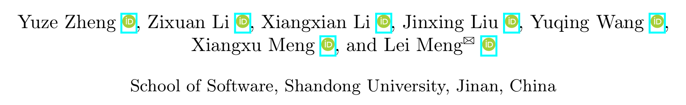



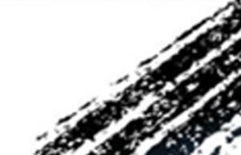

ATAI
Advanced Technique of Artificial Intelligence
ATAI
ChongqingUniversity _{AdvancedTechniqueof}
of Technology Artificial Intelligence
Chongqing University of
Technology
Chongqing University ^{ATAI}
_{of Technology} Advanced Techniqueof
Artificial Intelligence
Chongqing University of Technology
Chongqing University of Technology
Unifying Visual and Semantic Feature Spaces with Diffusion
Models for Enhanced Cross-Modal Alignment
Code : None
—— CVPR’2024
Reported by Yang Jiang
1

Slide 2
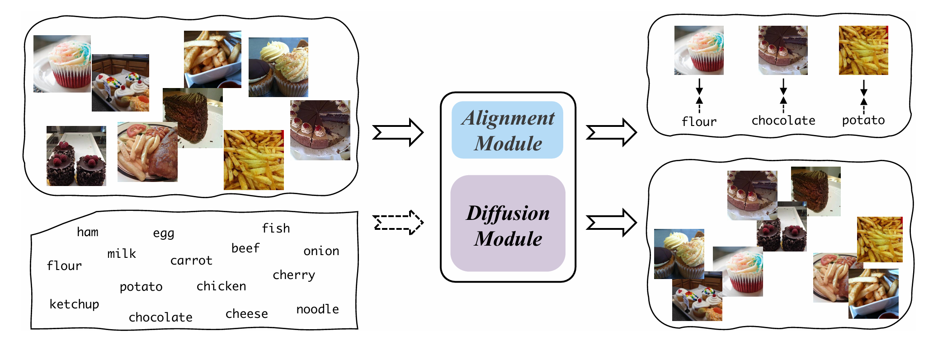
ATAI
Advanced Technique of Artificial Intelligence
ATAI
ChongqingUniversity _{AdvancedTechniqueof}
of Technology Artificial Intelligence
Chongqing University of
Technology
Chongqing University ^{ATAI}
_{of Technology} Advanced Techniqueof
Artificial Intelligence
Chongqing University of Technology
Chongqing University of Technology
Introduction
1. However, both methods tend to focus on the distance between representations while aligning cross-modal representations as much as possible, neglecting the significant distribution differences between different modal representations.

Slide 3
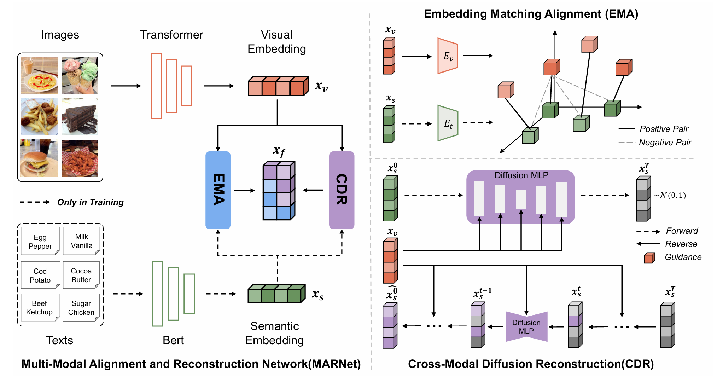
ATAI
Advanced Technique of Artificial Intelligence
ATAI
ChongqingUniversity _{AdvancedTechniqueof}
of Technology Artificial Intelligence
Chongqing University of
Technology
Chongqing University ^{ATAI}
_{of Technology} Advanced Techniqueof
Artificial Intelligence
Chongqing University of Technology
Chongqing University of Technology
Overview

Slide 4
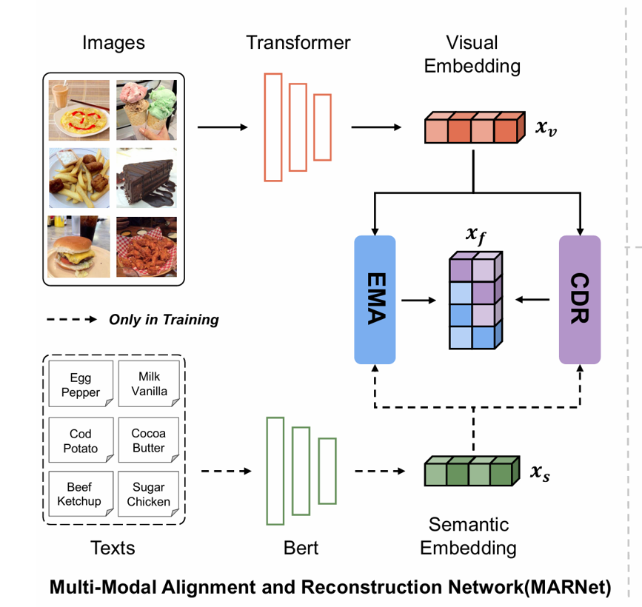

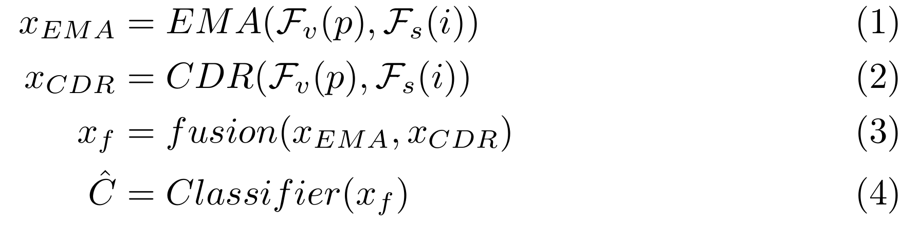
ATAI
Advanced Technique of Artificial Intelligence
ATAI
ChongqingUniversity _{AdvancedTechniqueof}
of Technology Artificial Intelligence
Chongqing University of
Technology
Chongqing University ^{ATAI}
_{of Technology} Advanced Techniqueof
Artificial Intelligence
Chongqing University of Technology
Chongqing University of Technology
Definition
Training samples
Test samples

Slide 5
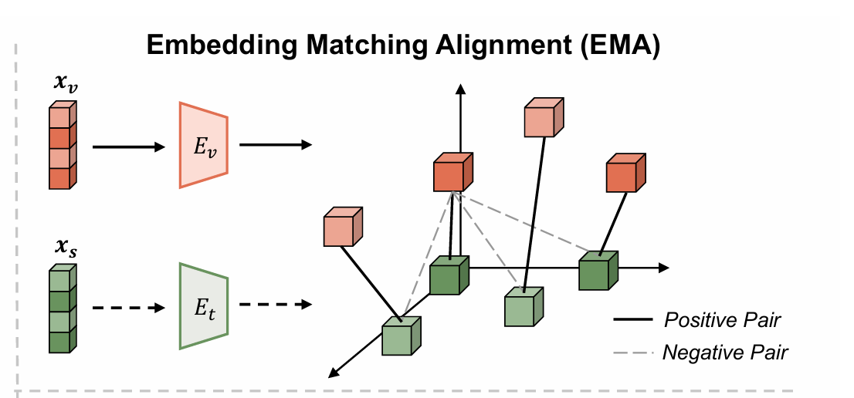
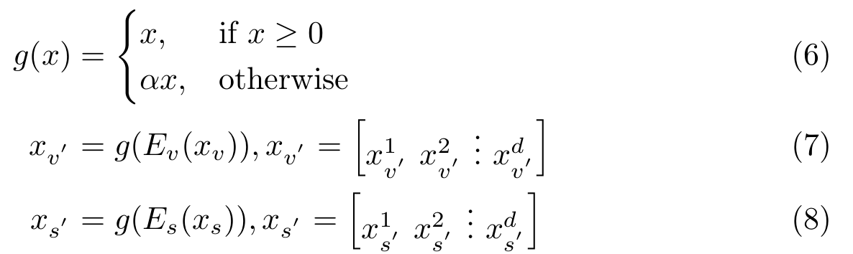
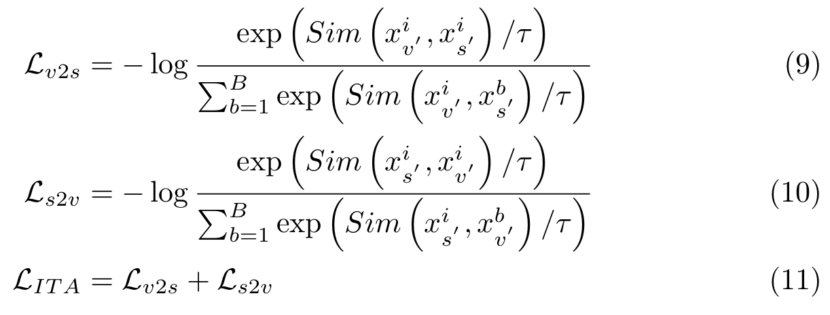
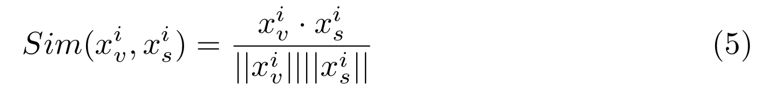
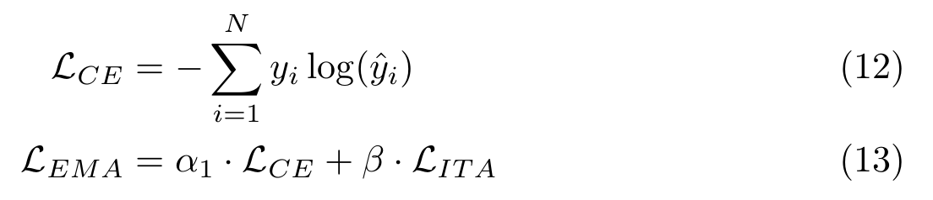
ATAI
Advanced Technique of Artificial Intelligence
ATAI
ChongqingUniversity _{AdvancedTechniqueof}
of Technology Artificial Intelligence
Chongqing University of
Technology
Chongqing University ^{ATAI}
_{of Technology} Advanced Techniqueof
Artificial Intelligence
Chongqing University of Technology
Chongqing University of Technology
Method

Slide 6
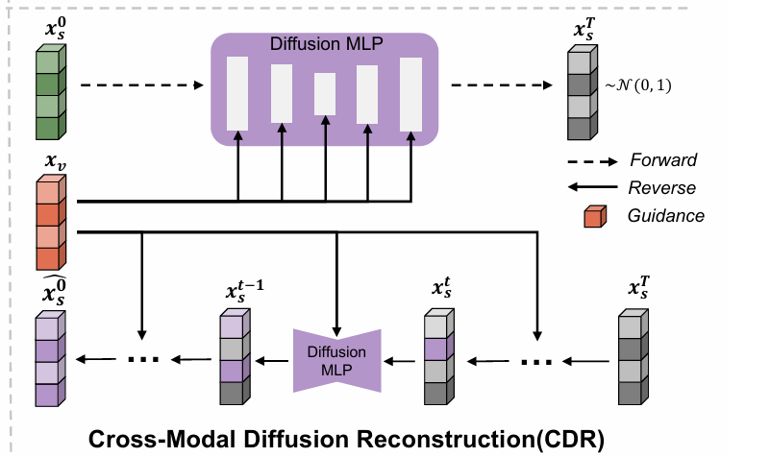
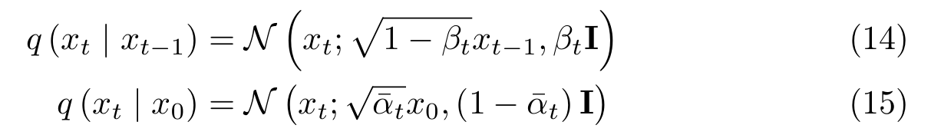
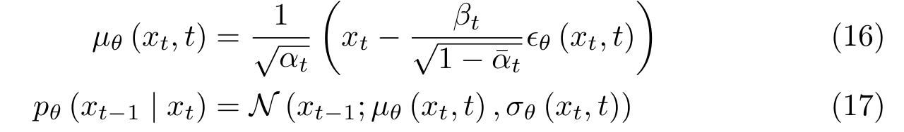
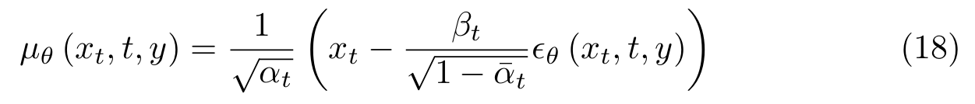
ATAI
Advanced Technique of Artificial Intelligence
ATAI
ChongqingUniversity _{AdvancedTechniqueof}
of Technology Artificial Intelligence
Chongqing University of
Technology
Chongqing University ^{ATAI}
_{of Technology} Advanced Techniqueof
Artificial Intelligence
Chongqing University of Technology
Chongqing University of Technology
Method
Background of Diffusion Models
Forward process
reverse process

Slide 7
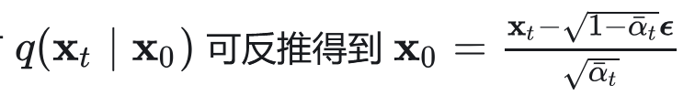
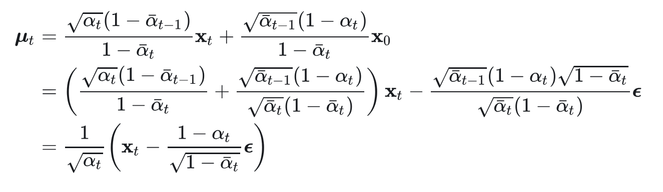
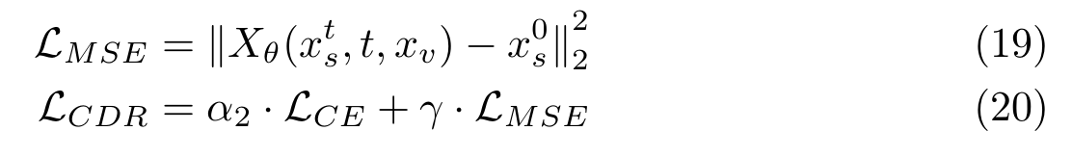
ATAI
Advanced Technique of Artificial Intelligence
ATAI
ChongqingUniversity _{AdvancedTechniqueof}
of Technology Artificial Intelligence
Chongqing University of
Technology
Chongqing University ^{ATAI}
_{of Technology} Advanced Techniqueof
Artificial Intelligence
Chongqing University of Technology
Chongqing University of Technology
Method
Cross-Modal Reconstruction

Slide 8
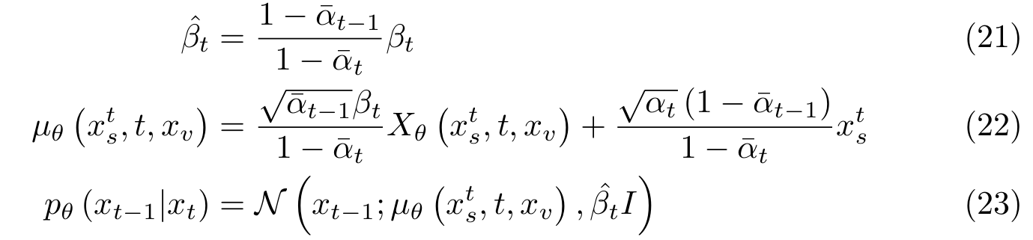
ATAI
Advanced Technique of Artificial Intelligence
ATAI
ChongqingUniversity _{AdvancedTechniqueof}
of Technology Artificial Intelligence
Chongqing University of
Technology
Chongqing University ^{ATAI}
_{of Technology} Advanced Techniqueof
Artificial Intelligence
Chongqing University of Technology
Chongqing University of Technology
Method
Cross-Modal Reconstruction

Slide 9
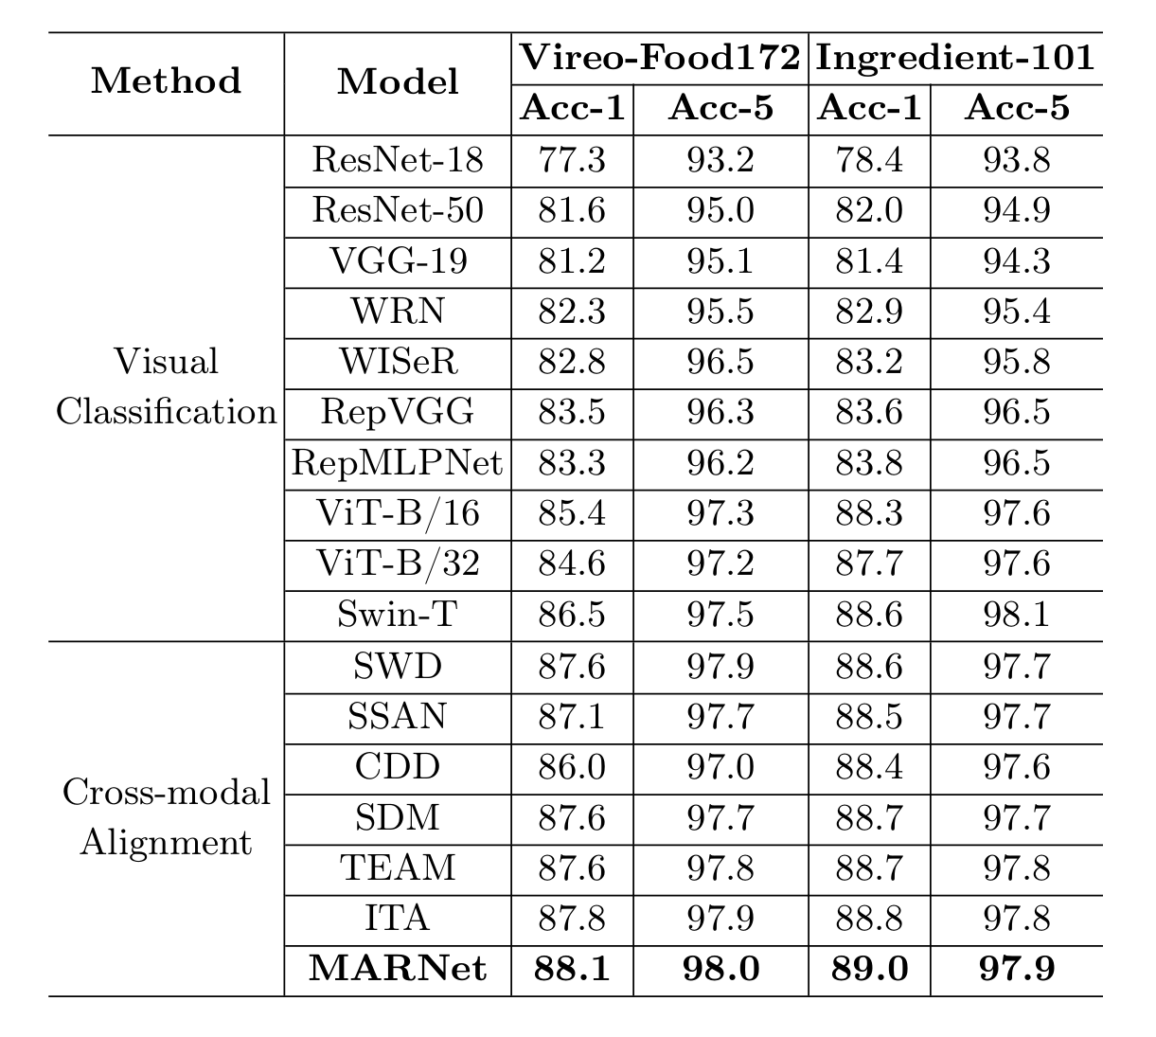
ATAI
Advanced Technique of Artificial Intelligence
ATAI
ChongqingUniversity _{AdvancedTechniqueof}
of Technology Artificial Intelligence
Chongqing University of
Technology
Chongqing University ^{ATAI}
_{of Technology} Advanced Techniqueof
Artificial Intelligence
Chongqing University of Technology
Chongqing University of Technology
Experiments

Slide 10
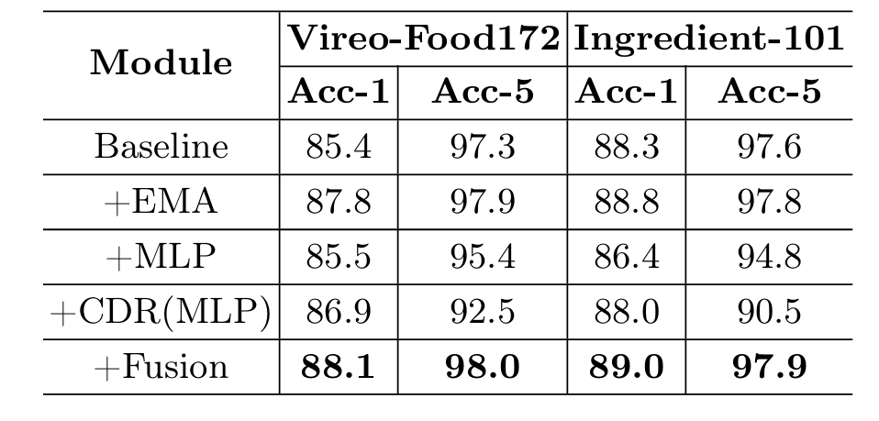
ATAI
Advanced Technique of Artificial Intelligence
ATAI
ChongqingUniversity _{AdvancedTechniqueof}
of Technology Artificial Intelligence
Chongqing University of
Technology
Chongqing University ^{ATAI}
_{of Technology} Advanced Techniqueof
Artificial Intelligence
Chongqing University of Technology
Chongqing University of Technology
Experiments

Slide 11
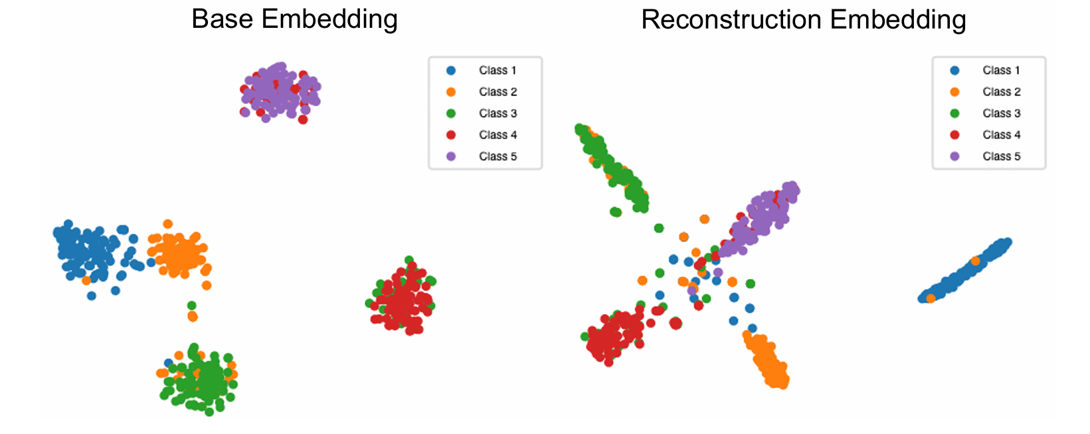
ATAI
Advanced Technique of Artificial Intelligence
ATAI
ChongqingUniversity _{AdvancedTechniqueof}
of Technology Artificial Intelligence
Chongqing University of
Technology
Chongqing University ^{ATAI}
_{of Technology} Advanced Techniqueof
Artificial Intelligence
Chongqing University of Technology
Chongqing University of Technology
Experiments

Slide 12
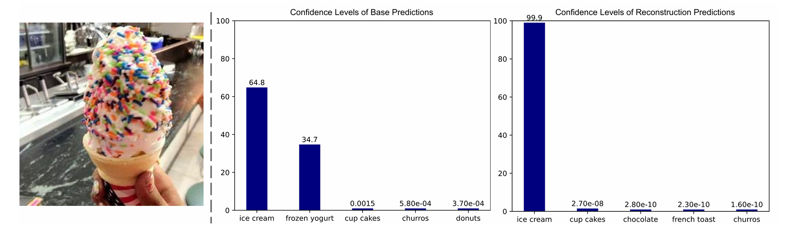
ATAI
Advanced Technique of Artificial Intelligence
ATAI
ChongqingUniversity _{AdvancedTechniqueof}
of Technology Artificial Intelligence
Chongqing University of
Technology
Chongqing University ^{ATAI}
_{of Technology} Advanced Techniqueof
Artificial Intelligence
Chongqing University of Technology
Chongqing University of Technology
Experiments

Slide 13


ATAI
Advanced Technique of Artificial Intelligence
ATAI
ChongqingUniversity _{AdvancedTechniqueof}
of Technology Artificial Intelligence
Chongqing University of
Technology
Chongqing University ^{ATAI}
_{of Technology} Advanced Techniqueof
Artificial Intelligence
Chongqing University of Technology
Chongqing University of Technology
Thanks!

